Slide 1
ARSITEKTUR INSTRUCTION SET
Instruction set adalah satu set perintah yang dapat dilaksanakan oleh sebuah
prosesor
Dari sudut pandang seorang pemrogram :
Instruction set memberikan gambaran operasi operasi dasar yang dapat
dikerjakan prosesor ybs dan dapat dieksploitasi oleh pemrogram sistem
(Programmer’s model of the machine).
Dari sudut perancang hardware :
Instruction set memberikan gambaran kemampuan kemampuan dasar yang
harus diimplementasikan secara hardware.
software
  Arsitektur Instruction Set (ISA) memberikan
  interface antara hardware dan software.
instruction set
hardware

Slide 2
Programmer’s model of the machine
0
63
0
32 register-
floating point
64-bit
M 6800
7
0
31
A
0
31
15
B
0
I X
32 register-
general pur-pose 32-bit
special Purpose
Register
Power PC
XP
PC
31
0
31
PSW
0
>50 register-
special pur-pose 32-bit
0
2¹⁶ bytes
main memory
capacity
31
0
31
2¹⁶ -1
0
2³² bytes
main memory

Slide 3
Organisasi elemen elemen penyimpanan yang dapat diprogram
  register
  memory
  mode pengalamatan dan pengaksesan data (operand) dan
  instruksi

Slide 4
Kompilasi
Program dalam bahasa level tinggi
source program
Compiler
Program dalam bahasa assembly/
mesin
object program/code
- menggunakan statement atau
instruksi instruksi yang ada dalam
instruction set
- dieksekusi oleh prosesor

Slide 5
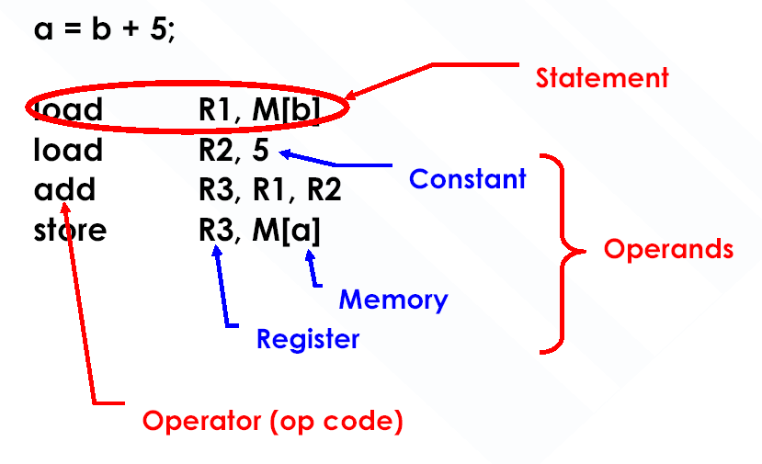
a = b + 5 1 statement level tinggi
kompilasi
1 statemen assembly =
1 instruksi mesin
M[a], R3
Operand operand
Register
Memory

Slide 6
Apa yang harus dispesifikasikan oleh sebuah instruksi ?
Kode operasi Opcode
  add r0, r1, r3
  add, load, branch, dsb.
Dimana operand-operand sumbernya berada ?
  add r0, r1, r3
didalam register2 CPU, main memory, I/O, atau terdapat dalam instruksi itu sendiri.
Kemana operand hasil (hasil operasi ) disimpan ?
  add r0, r1, r3
  ke register2 CPU atau main memory
Opcode Operand-operand sumber dan operand hasil
(alamat penyimpanannya)

Slide 7
Format Instruksi
Opcode/mnemonic | Operand1 | Operand2 | . . . | Operand_{N}
operand source/destination
Opcode : menyatakan operasinya (mnemonic)
Operands: menyatakan data input (source) dan output (destination)
untuk operasi ybs
datanya (imediate) atau
lokasi/alamat data (eks-
lisit atau implisit)

Slide 8
Klasifikasi Arsitektur Instruction Ser
1. Arsitektur Accumulator (sebelum 1960) :
1 alamat add A acc ← acc + mem[A]
2. Arsitektur Stack (1960s s/d 1970s) :
0 address add tos ←tos + (tos-1)
3. Arsitektur Memory-Memory (1970s s/d 1980s):
2 address add A, B mem[A] ← mem[A] + mem[B]
3 address add A, B, C mem[A] ←mem[B] + mem[C]
4. Arsitektur Register-Memory (1970 sampai sekarang):
2 address add R1, A R1 ← R1 + mem[A]
load R1, A R1 ← mem[A]
5. Arsitektur Register-Register (Load/Store) (1960ssampai sekarang):
3 address add R1, R2, R3 R1 ← R2 + R3
load R1, R2 R1 ← mem[R2]
store R1, R2 mem[R1] ← R2

Slide 9
Arsitektur Stack
Instruction set:
  add, sub, mult, div, . . .
  push A, pop A
Contoh : A*B - (A+C*B)
  1. push A
  2. push B
  3. mul
  4. push A
  5. push C
  6. push B
  7. mul
  8. add
  9. sub
1 2 3 4 5 6 7 8 9
A
B
A*B
A+B*C
?
A
C
B
B*C
A
A*B
A
C
A
A*B
A*B
A*B
A
A*B
hasil

Slide 10
Internak Stack : Letak Stack didalam CPU
I
n
s
t
r
u
c
t
i
o
n
f
o
r
m
a
t
s
M
e
m
o
r
y
C
P
U
p
u
s
h
O
p
1
(
T
O
S
ฌ
O
p
1
)
B
i
t
s
:
8
2
4
O
p
1
A
d
d
r
:
O
p
1
F
o
r
m
a
t
p
u
s
h
O
p
1
A
d
d
r
T
O
S
O
p
e
r
a
t
i
o
n
R
e
s
u
l
t
TOS-1
e
t
c
.
a
(TOS-1)
d
d
(
T
O
S
←
T
O
S
+
B
i
t
s
:
8
S
t
a
c
k
a
d
F
d
o
r
m
a
P
t
r
o
g
r
a
N
m
e
x
t
i
A
d
d
r
:
N
e
x
t
i
2
4
o
p
e
r
a
t
i
o
c
n
o
u
n
t
e
r
W
h
e
r
e
t
o
f
i
n
d
W
h
e
r
e
t
o
f
i
n
d
o
p
e
r
a
n
d
s
,
n
e
x
t
i
n
s
t
r
u
c
t
i
o
n
a
n
d
w
h
e
r
e
t
o
p
u
t
r
e
s
u
l
t
(
o
n
t
h
e
s
t
a
c
k
)

Slide 11
M
e
m
o
r
y
program
TOS
TOS-1
Stack (data)

Slide 12
Arsitektur Akumulator
Instruction Set
  add A, sub A, mult A, div A, . . .
  load A, store A
Contoh : kalkulasi A*B-(A+C*B)
  1. load B
  2. mul C
  3. add A
  4. store D
  5. load A
  6. mul B
  7. sub D
B
B*C
A+B*C
A+B*C
A
A*B
hasil

Slide 13
1-Address Machine and Instruction Format
C
P
M
U
e
m
o
r
y
a
d
d
O
p
1
(
A
c
c
ฌ
A
c
c
+
O
p
1
)
Special CPU register, the accumulator, supplies 1 operand and stores result
One memory address used for other operand
O
p
1
A
d
d
r
:
O
p
1
W
h
e
r
e
t
o
f
i
n
d
o
p
e
r
a
n
d
2
,
a
n
d
w
h
e
r
e
t
o
p
u
t
r
e
s
u
l
t
A
c
c
u
m
u
l
a
t
o
r
I
n
s
t
r
u
c
t
i
o
n
f
o
r
m
a
t
P
r
o
g
r
a
m
2
4
B
i
t
s
:
8
2
N
4
e
x
t
i
A
d
d
r
:
N
e
x
t
i
c
o
u
n
t
e
r
a
d
d
O
p
1
A
d
d
W
r
h
e
r
e
t
o
f
i
n
d
n
e
x
t
i
n
s
t
r
u
c
t
i
o
n
W
h
i
c
h
W
h
e
r
e
t
o
f
i
n
Need instructions to load and store operands:
LDA OpAddr
STA OpAddr
d
o
p
e
r
a
t
i
o
n
o
p
e
r
a
n
d
1

Slide 14
Memory-Memory Architectures
Instruction set:
  (3 operands) add A, B, C sub A, B, C mul A, B, C
  (2 operands) add A, B sub A, B mul A, B
Example: A*B - (A+C*B)
  3 operands 2 operands
    mul D, A, B mov D, A
    mul E, C, B mul D, B
    add E, A, E mov E, C
    sub E, D, E mul E, B
    add E, A
    sub E, D

Slide 15
The 2-Address Machine and Instruction Format
a
d
d
O
p
2
,
O
p
1
(
O
p
2
ฌ
O
p
2
+
O
p
1
C
)
P
M
U
e
m
o
r
y
Result overwrites Operand 2
Needs only 2 addresses in instruction but less choice in placing data
O
p
1
A
d
d
r
:
O
p
1
O
p
2
A
d
d
r
:
O
p
2
,
R
e
s
I
n
s
t
r
u
c
t
i
o
n
f
o
r
m
a
P
t
r
o
g
r
a
m
2
N
4
e
x
t
i
A
d
d
r
:
N
e
x
t
i
c
o
u
n
t
e
r
B
i
t
s
:
8
2
4
2
4
W
h
e
r
e
t
o
f
i
n
d
a
d
d
O
p
2
A
d
d
r
O
p
1
A
d
d
n
r
e
x
t
i
n
s
t
r
u
c
t
i
o
n
W
h
i
c
h
W
h
e
r
e
t
o
f
i
n
d
o
p
e
r
a
n
d
s
o
p
e
r
a
t
i
o
n
W
h
e
r
e
t
o
p
u
t
r
e
s
u
l
t

Slide 16
Register-Memory Architectures
Instruction Set:
  add R1, A sub R1, A mul R1, B
  load R1, A store R1, A
Example: A*B - (A+C*B)
  mul R1, B /* A*B */
  store R1, D
  load R2, C
  mul R2, B /* C*B */
  add R2, A /* A + CB */
  sub R2, D /* AB - (A + C*B) */

Slide 17
Load-Store Architectures
Instruction Set:
  add R1, R2, R3 sub R1, R2, R3 mul R1, R2, R3
  load R1, R4 store R1, R4
Example: A*B - (A+C*B)
  load R2, &B
  load R3, &C
  load R4, R1
  load R5, R2
  load R6, R3
  mul R7, R6, R5 /* C*B */
  add R8, R7, R4 /* A + C*B */
  mul R9, R4, R5 /* A*B */
  sub R10, R9, R8 /* A*B - (A+C*B) */

Slide 18
The 3-Address Machine and Instruction format
Memory
CPU
Address of next instruction kept in processor state register—the PC (except for explicit branches/jumps)
Rest of addresses in instruction
  Discuss: savings in instruction word size
a
d
d
,
R
e
s
,
O
p
1
,
O
p
2
(
R
e
s
ฌ
O
p
2
+
O
p
1
)
O
p
1
A
d
d
r
:
O
p
1
O
p
2
A
d
d
r
:
O
p
2
R
e
s
A
d
d
r
:
R
e
s
I
n
s
t
r
u
c
t
i
o
n
f
o
r
m
a
t
B
i
t
s
:
8
2
4
2
4
2
P
4
r
o
g
r
a
m
2
N
4
e
x
t
i
A
d
d
r
:
N
e
x
t
i
c
o
u
n
t
e
r
a
d
d
R
e
s
A
d
d
r
O
p
1
A
d
d
r
O
p
2
A
d
d
r
W
h
e
r
e
t
o
f
i
n
d
W
h
i
c
h
W
h
e
r
e
t
o
W
h
e
r
e
t
o
f
i
n
d
o
p
e
r
a
n
d
n
s
e
x
t
i
n
s
t
r
u
c
t
i
o
n
o
p
e
r
a
t
i
o
n
p
u
t
r
e
s
u
l
t

Slide 19
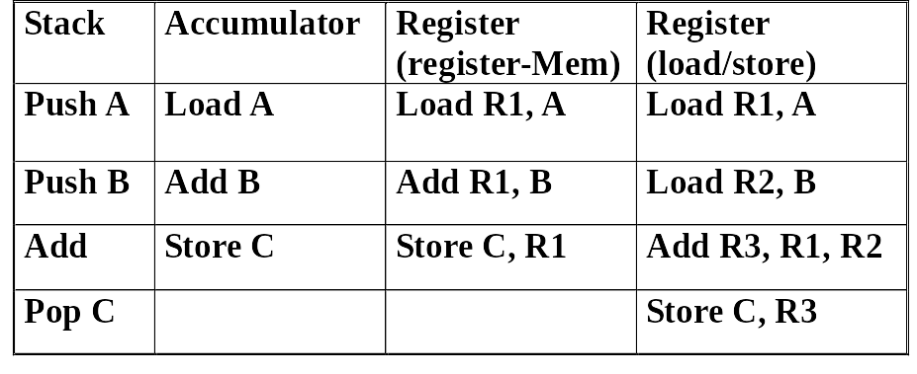
Perbandingan Arsitektur Instruction Set
runtun instruksi untuk kalkulasi C = A + B
Efisiensi : Penyimpanan di Memory?
Pengaksesan Instruksi?
Pengaksesan Data?

Slide 20
Berdasarkan jumlah operand dalam instruksi
Mesin n alamat
n = jumlah operand
0 - alamat | 1 - alamat | 2 - alamat | 3 - alamat
Halt | Push R1 | Store M, R1 | Add R3, R1, R2
Shl | Load M | Add R3, R1 | Mult M, R1, R2
Pop | Add B | Rot R2, R1
lokasi operand-
nya :
implisit 1 eksplisit, 2 eksplisit 3 eksplisit
operand lain (kalau ada), lokasinya implisit

Slide 21
Untuk ekspresi level tinggi A = B * C + D
Panjang alamat dan panjang data adalah 2 byte, panjang opcode 1 byte.
Operand ditransfer dari dan ke memory dengan ukuran 2 byte/transfer.
satuan transfer
Dengan instruksi 3 – alamat , programnya adalah :
mult A, B, C
  add A, A, D
ukuran program
2 [1+2+2+2] = 14 byte
Trafik antara memory dengan CPU
Trafik Instruksi : Untuk mengeksekusi sebuah instruksi, instruksi tsb
harus ditransfer dari memory ke CPU melalui bus data.
Opcode 1 byte akan ditransfer dalam satuan transfer
2 byte/transfer.
Operand : Jumlah operand = jumlah transfer

Slide 22
alamat data
 | mult
 | A
 | B
 | C
 | add
 | A
 | A
 | D
A
B
C
D
CPU
4X2 byte
Trafik memory :
Instruksi 16 byte
Operand 12 byte
28 byte
16 byte
4X2 byte
catatan :
opcode 1 byte disimpan
pada lokasi 2 byte di
memory
x
+
6 x 2 byte
2 byte 2 byte

Slide 23
  • Untuk instruksi 2-alamat :
  load B, A
  mult C, A
  add D, A
  Ukuran program 15 bytes. Memory traffic 31 bytes.
  Untuk Instruksi 1-alamat :
  load B
  mult C
  add D
  store A
  Ukuran program 16 byte, dan memory traffic 24 bytes.

Slide 24
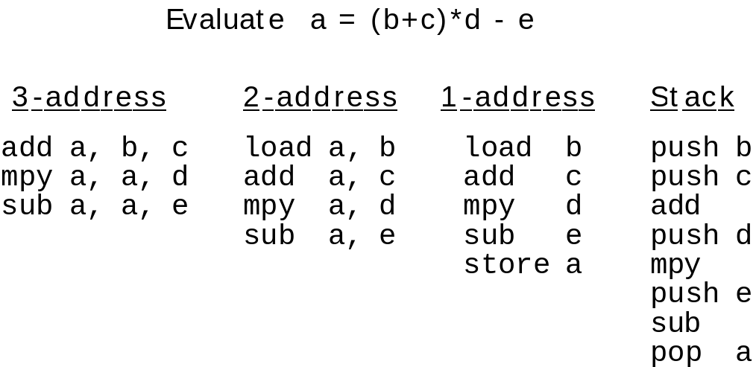
Evaluasi untuk a = (b+c) * d - e

Slide 25
General Register Machine and Instruction Formats
C
P
U
I
n
s
t
r
u
c
t
i
o
n
f
o
r
m
a
t
R
s
e
g
i
s
t
e
r
M
s
e
m
o
r
y
l
o
a
d
R
8
,
O
p
1
(
R
8
ฌ
O
p
1
l
)
o
a
d
R
O
8
p
1
A
d
d
r
:
O
p
1
l
o
a
d
R
8
O
p
1
A
d
d
r
R
6
R
4
a
d
d
R
2
,
R
4
,
R
6
(
R
2
ฌ
R
4
+
R
6
)
a
d
d
R
2
R
4
R
R
6
2
P
r
o
g
r
a
N
m
e
x
t
i
c
o
u
n
t
e
r

Slide 26
General Register Machine and Instruction Formats
It is the most common choice in today’s general-purpose computers
Which register is specified by small “address” (3 to 6 bits for 8 to 64 registers)
Load and store have one long & one short address: 1- addresses
Arithmetic instruction has 3 “half” addresses

Slide 27
Real Machines Are Not So Simple
Most real machines have a mixture of 3, 2, 1, 0, and 1- address instructions
A distinction can be made on whether arithmetic instructions use data from memory
If ALU instructions only use registers for operands and result, machine type is load-store
  Only load and store instructions reference memory
Other machines have a mix of register-memory and memory-memory instructions

Slide 28
Ragam Pengalamatan (Addressing Mode)
Menunjukkan cara pengalamatan operand → cara menginterpretasikan
medan operand pada sebuah instruksi
Pengalamatan Immediate
Contoh : Add R4, # 3 Regs[R4] ← Regs[R4] + 3
Pengalamatan Register
Contoh : Add R4, R3 Regs[R4] ← Regs[R4]+Regs[R3]
operand
source
destination
R4
+
R3
R4
+

Slide 29
3. Pengalamatan Register tak-langsung
Contoh : Add R4, (R1)
Regs[R4] ← Regs[R4]+Mem[Regs[R1]]
EA : Effective Adress (alamat dimana
operand berada)
memory
R1
EA
R4
alamat
+
4. Pengalamatan Langsung
Contoh : Add R4, (1001) Regs[R4] ← Regs[R4]+Mem[1001]
R4
EA
1001
+

Slide 30
5. Memory tak-langsung
Add R4, @(R3) Regs[R4] ← Regs[R4]+Mem[Mem[Regs[R3]]]
(Memory Indirect)
R3
a
a
b
R4
b
EA = b
+
6. Pengalamatan Displacement
Add R4, 100(R1) Regs[R4] ← Regs[R4]+Mem[100+R1]
100
R1
a
R4
100+a
+
+

Slide 31
Tipe Operasi
Aritmatik and Logika
add, subtract, and , or, ...
Transfer Data
Load, Store, In, Out, ....
Control
Jump, branch, call, return, trap,...
Sinkronisasi
Test & Set.

Slide 32
Persentase penggunaan instruksi (Intel x86)
1
Load
22%
2
Conditional branch
20%
3
Compare
16%
4
Store
12%
5
Add
8%
6
And
6%
7
Sub
5%
8
Move register-register
4%
9
Call
1%
Instruksi instruksi sederhana mendominasi penggunaan dalam
penulisan program

Slide 33
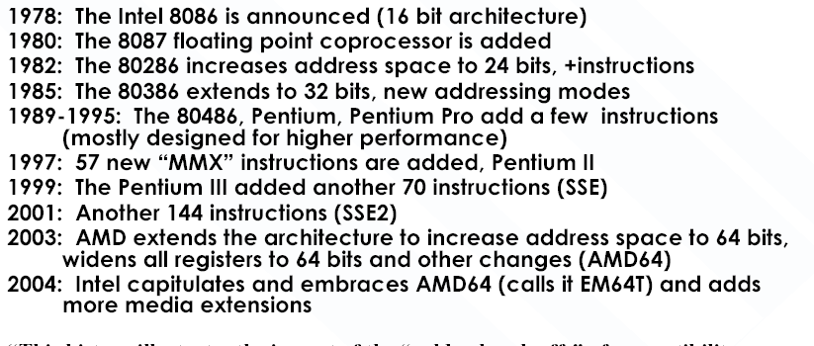

Slide 34
RISC Vs. CISC
Complex Instruction Set Computer:
  instruction setnya “kaya” (fungsi fungsinya banyak)
  decodingnya kompleks
  analisis untuk mengidentikasikan ketergantungan
  antar instruksi sangat kompleks.
Reduced Instruction Set Computer:
  instruction setnya sederhana, terdiri dari sejumlah kecil
  instruksi dasar hardwarenya lebih sederhana.
  analisis untuk mengidentikasikan ketergantungan antar instruksi
  lebih mudah, sehingga memudahkan ekstraksi keparalelan antar-
  instruksi (untuk pemaralelan eksekusi instruksi).

Slide 35
Byte Ordering
Idea
  Bytes in long word numbered 0 to 3
  Which is most (least) significant?
  Can cause problems when exchanging binary data between machines
Big Endian: Byte 0 is most, 3 is least
  IBM 360/370, Motorola 68K, Sparc.
Little Endian: Byte 0 is least, 3 is most
  Intel x86, VAX
Alpha
  Chip can be configured to operate either way
  DEC workstation are little endian
  Cray T3E Alpha’s are big endian

Slide 36
Byte Ordering Example (1/2)
union {
unsigned char c[8];
unsigned short s[4];
unsigned int i[2];
unsigned long l[1];
} dw;
c[0]
c[1]
c[2]
c[3]
c[4]
c[5]
c[6]
c[7]
s[0]
s[1]
s[2]
s[3]
i[0]
i[1]
l[0]

Slide 37
Byte Ordering on Alpha
Little Endian
f0
f1
f2
f3
f4
f5
f6
f7
c[0]
c[1]
c[2]
c[3]
c[4]
c[5]
c[6]
c[7]
LSB
MSB
LSB
MSB
LSB
MSB
LSB
MSB
s[0]
s[1]
s[2]
s[3]
LSB
MSB
LSB
MSB
i[0]
i[1]
LSB
MSB
l[0]
Print
Output on Alpha:

Slide 38
Byte Ordering on x86
Little Endian
f0
f1
f2
f3
f4
f5
f6
f7
c[0]
c[1]
c[2]
c[3]
c[4]
c[5]
c[6]
c[7]
LSB
MSB
LSB
MSB
LSB
MSB
LSB
MSB
s[0]
s[1]
s[2]
s[3]
LSB
MSB
LSB
MSB
i[0]
i[1]
LSB
MSB
l[0]
Print
Output on Pentium:

Slide 39
Byte Ordering on Sun
Big Endian
f0
f1
f2
f3
f4
f5
f6
f7
c[0]
c[1]
c[2]
c[3]
c[4]
c[5]
c[6]
c[7]
MSB
LSB
MSB
LSB
MSB
LSB
MSB
LSB
s[0]
s[1]
s[2]
s[3]
MSB
LSB
MSB
LSB
i[0]
i[1]
MSB
LSB
l[0]
Print
Output on Sun:
Characters 0-7 == [0xf0,0xf1,0xf2,0xf3,0xf4,0xf5,0xf6,0xf7]
Shorts 0-3 == [0xf0f1,0xf2f3,0xf4f5,0xf6f7]
Ints 0-1 == [0xf0f1f2f3,0xf4f5f6f7]
Long 0 == [0xf0f1f2f3]

Slide 40
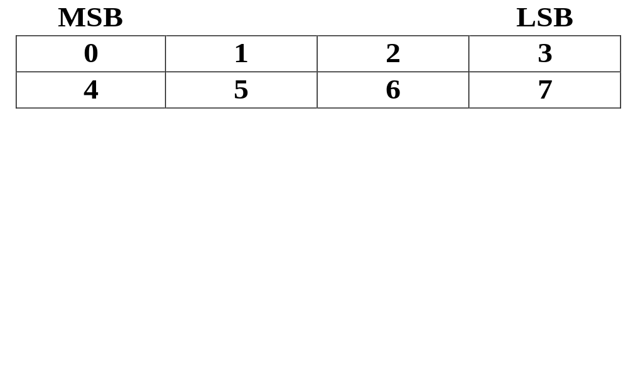
Big Endian Addressing
With Big Endian addressing, the byte binary address
    x . . . x00
is in the most significant position (big end) of a 32 bit word (IBM, Motorola, Sun, HP).

Slide 41
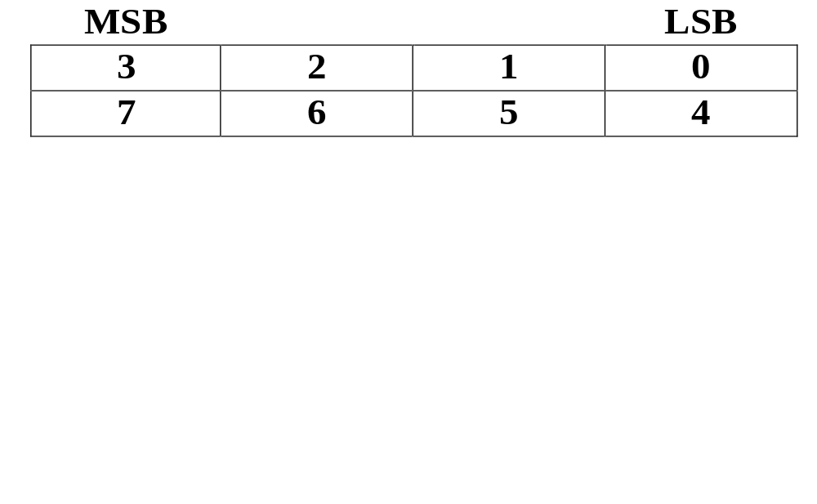
Little Endian Addressing
With Little Endian addressing, the byte binary address
    x . . . x00
is in the least significant position (little end) of a 32 bit word (DEC, Intel).

Slide 42
Idea
  Bytes in long word numbered 0 to 3
  Which is most (least) significant?
  Can cause problems when exchanging binary data between machines
Big Endian: Byte 0 is most, 3 is least
  IBM 360/370, Motorola 68K, Sparc.
Little Endian: Byte 0 is least, 3 is most
  Intel x86, VAX
Alpha
  Chip can be configured to operate either way
  DEC workstation are little endian
  Cray T3E Alpha’s are big endian

Slide 43
4 digit desimal
2 | 0 | 0 | 5
BCD coding
4 bit/digit-desimal
0 | 0 | 1 | 0
0 | 0 | 0 | 0
0 | 0 | 0 | 0
0 | 1 | 0 | 1
byte 1
byte 0
= LSB
= MSB
Memory
Memory
alamat
alamat
a
a+1
a
a+1
Big
Endian
Little
Endian
1 byte
1 byte

Slide 44
4 digit karakter
H | A | I
ASCII coding
8 bit/digit-karakter
byte 3
byte 1
byte 0
a
a+1
a+2
= LSB
a
a+1
a+2
= MSB

